Slide 1
WT-411i2 & WT-454i2 Considerations on Inventory & Topology
Haomian Zheng, Guoxiang Liu
May 30, 2023

Slide 2
Background Information from Nokia Starts here...

Slide 3
Equipment Inventory and Topology in BBF TR-454
BBF equipment inventory
BBF-defined YANG module, listing three “sub-” inventories:
(Network) devices (PNFs)
with optional HW, management and SW information
pANs: virtual representation of AN PNFs (=PMA representation) with leaf-ref to device
With attributes related to datastore (model, alignment), admin state, device –adapters (BAA)
End-user devices
HW, management and SW info attributes
BBF network map
Uses ietf-network-topology with several augmentations
E.g. geo/site/responsible information augmentation for the network nodes
Leaf references to “BBF Equipment inventory” YANG module for “node ID” and “end-user-device-ID”
Enables to link network nodes with each other without using ietf-network-topology “link” and “termination point” definitions, instead leveraging “deployment topology”/“connected node” augmentation for nodes
Both Inventory and network map are defined for “CloudCO’s Northbound API”
No explicit reference to TR 411 Occo-Nf-sdn-access (CloudCO DO –Access SDN M&C interface)

Slide 4
TR 451: “the data provided by the models in this TR (454) can be exposed to management systems through the CloudCO's Northbound API as is; as a reduced set of instance data or data elements; abstracted into a different Network Map or Equipment inventory model representation”
TR-454
bbf-equipment-inventory
ro: for non-configuration data nodes and choice nodes, output parameters to rpcs and actions, and notification parameter
(RFC 8340, YANG Tree Diagrams)
Leafref, referring to device id defined in equipment-inventory for network devices and end-user devices under node
TR-454
bbf-network-map
rw: for configuration data nodes and choice nodes
Augment node
Augment network
Augment termination point
import
Leaf Tenant-ID
import
RFC 8345
Ietf-network-topology
Ietf-network
module: ietf-network
+--rw networks
+--rw network* [network-id]
+--rw network-id network-id
+--rw network-types
+--rw supporting-network* [network-ref]
| +--rw network-ref -> /networks/network/network-id
+--rw node* [node-id]
+--rw node-id node-id
+--rw supporting-node* [network-ref node-ref]
+--rw network-ref -> ../../../supporting-network/network-ref
+--rw node-ref -> /networks/network/node/node-id
module: ietf-network-topology
augment /nw:networks/nw:network:
+--rw link* [link-id]
+--rw link-id link-id
+--rw source
| +--rw source-node? -> ../../../nw:node/node-id
| +--rw source-tp? -> ../../../nw:node[nw:node-id=current()/../source-node]/termination-point/tp-id
+--rw destination
| +--rw dest-node? -> ../../../nw:node/node-id
| +--rw dest-tp? -> ../../../nw:node[nw:node-id=current()/../dest-node]/termination-point/tp-id
+--rw supporting-link* [network-ref link-ref]
+--rw network-ref -> ../../../nw:supporting-network/network-ref
+--rw link-ref -> /nw:networks/network[nw:network-id=current()/../network-ref]/link/link-id
augment /nw:networks/nw:network/nw:node:
+--rw termination-point* [tp-id]
+--rw tp-id tp-id
+--rw supporting-termination-point* [network-ref node-ref tp-ref]
+--rw network-ref -> ../../../nw:supporting-node/network-ref
+--rw node-ref -> ../../../nw:supporting-node/node-ref
+--rw tp-ref -> /nw:networks/network[nw:network-id=current()/../network-ref]/node[nw:node-id=current()/../node-ref]/termination-point/tp-id
network
-supporting network
-node
-supporting node
network
-supporting network
-node
-supporting node
-termination point
-supporting termination point
-link
-supporting link
Augment network
Augment node

Slide 5
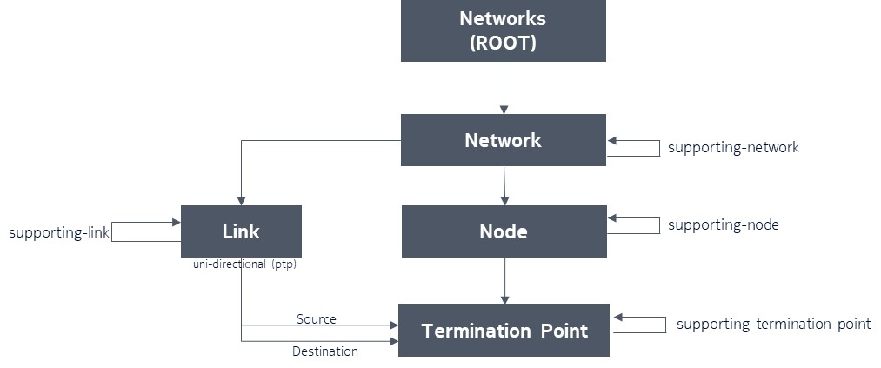
RFC 8345

Slide 6
TR-454
module: bbf-equipment-inventory
+--ro equipment-inventory {bbf-inv:reports-equipment-inventory}?
+--ro device-inventory {bbf-inv:reports-device-inventory}?
| +--ro device* [device-id]
| +--ro device-id string
| +--ro hardware-info
| | +--ro device-type? identityref
| | +--ro serial-num? bbf-yang:string-ascii64
| | +--ro mfg-name? bbf-yang:string-ascii64
| | +--ro model-name? bbf-yang:string-ascii64
| +--ro management-info
| | +--ro ip-address? inet:host
| | +--ro port? inet:port-number
| | +--ro admin-state? bbf-nodet:admin-state
| +--ro software-info
| +--ro software-instance* [software-type current-revision]
| +--ro software-type identityref
| +--ro current-revision bbf-yang:string-ascii64
| +--ro previous-revision? bbf-yang:string-ascii64
| +--ro current-revision-last-changed? yang:date-and-time
+--ro pan-info {bbf-inv:reports-baa-pan-inventory}?
| +--ro pan-instance* [pan-id]
| +--ro pan-id bbf-yang:string-ascii64
| +--ro device-ref? -> /equipment-inventory/device-inventory/device/device-id {bbf-inv:reports-device-inventory}?
| +--ro admin-state? bbf-node-types:admin-state
| +--ro admin-state-change-timestamp? yang:date-and-time
| +--ro datastore
| | +--ro metamodel* string
| | +--ro metamodel-alignment-state? bbf-node-types:alignment-state
| | +--ro schema-update-timestamp? yang:date-and-time
| | +--ro an-alignment-state? bbf-node-types:alignment-state
| | +--ro an-alignment-state-change-timestamp? yang:date-and-time
| +--ro device-adapter
| +--ro software-type? identityref
| +--ro current-revision? bbf-yang:string-ascii64
| +--ro previous-revision? bbf-yang:string-ascii64
| +--ro current-revision-last-changed? yang:date-and-time
| +--ro alignment-state-update-timestamp? yang:date-and-time
+--ro eud-inventory {bbf-inv:reports-end-user-device-inventory}?
+--ro eud-equipment* [eud-id]
+--ro eud-id string
+--ro hardware-info
| +--ro device-type? identityref
| +--ro serial-num? bbf-yang:string-ascii64
| +--ro mfg-name? bbf-yang:string-ascii64
| +--ro model-name? bbf-yang:string-ascii64
+--ro management-info
| +--ro ip-address? inet:host
| +--ro port? inet:port-number
| +--ro admin-state? bbf-nodet:admin-state
+--ro software-info
+--ro software-instance* [software-type current-revision]
+--ro software-type identityref
+--ro current-revision bbf-yang:string-ascii64
+--ro previous-revision? bbf-yang:string-ascii64
+--ro current-revision-last-changed? yang:date-and-time
module: bbf-network-map
augment /nw:networks/nw:network:
+--rw tenant-id? string {bbf-nm:reports-network-map}?
augment /nw:networks/nw:network/nw:node:
+--rw node-type? identityref {bbf-nm:reports-network-map}?
+--rw network-device-properties {bbf-nm:reports-network-map}?
| +--rw alias? bbf-yang:string-ascii64
| +--rw device-ref? -> /bbf-inv:equipment-inventory/device-inventory/device/device-id {bbf-inv:reports-equipment-inventory,bbf-inv:reports-device-inventory}?
+--rw enduser-device-properties {bbf-nm:reports-network-map}?
| +--rw end-users
| | +--rw end-user* [end-user-id]
| | +--rw end-user-id bbf-yang:string-ascii64
| | +--rw given-name? bbf-yang:string-ascii64
| | +--rw family-name? bbf-yang:string-ascii64
| | +--rw contact* [type]
| | +--rw type bbf-yang:string-ascii64
| | +--rw value? bbf-yang:string-ascii64
| +--rw device-ref? -> /bbf-inv:equipment-inventory/eud-inventory/eud-equipment/eud-id {bbf-inv:reports-equipment-inventory,bbf-inv:reports-end-user-device-inventory}?
+--rw geographic-location {bbf-nm:reports-network-map}?
| +--rw civic-address
| | +--rw civic-address* [label value]
| | +--rw label enumeration
| | +--rw value string
| +--rw wgs84-location {bbf-loc:wgs84-location-support}?
| +--rw latitude? string
| +--rw longitude? string
+--rw responsible-party-contact {bbf-nm:reports-network-map}?
| +--rw given-name? bbf-yang:string-ascii64
| +--rw family-name? bbf-yang:string-ascii64
| +--rw contact* [type]
| +--rw type bbf-yang:string-ascii64
| +--rw value? bbf-yang:string-ascii64
+--rw site {bbf-nm:reports-network-map}?
| +--rw site-type? identityref
| +--rw plant-type? identityref
| +--rw building? bbf-yang:string-ascii64
| +--rw floor? bbf-yang:string-ascii64
| +--rw room? bbf-yang:string-ascii64
| +--rw line? uint16
| +--rw rack-position? uint16
| +--rw frame-position? uint16
+--rw deployment-topology {bbf-nm:reports-network-map}?
+--rw deployment-type? identityref
+--rw connected-node* [network-ref node-ref]
+--rw network-ref -> /nw:networks/network/supporting-network/network-ref
+--rw node-ref -> /nw:networks/network/node/node-id
augment /nw:networks/nw:network/nw:node/nt:termination-point:
+--rw distribution-frame-type? identityref {bbf-nm:reports-network-map}?
+--rw geographic-location {bbf-nm:reports-network-map}?
+--rw civic-address
| +--rw civic-address* [label value]
| +--rw label enumeration
| +--rw value string
+--rw wgs84-location {bbf-loc:wgs84-location-support}?
+--rw latitude? string
+--rw longitude? string
Allows to specify which nodes interconnect with each other,
Without using the link and termination point node definitions of “ietf-network-topology”

Slide 7
draft-ietf-ccamp-network-inventory-yang-01 A YANG Data Model for Network Hardware Inventory
Network Hardware Inventory in IETF
[RFC8345] initial goal was to make possible the augmentation of the YANG data model with network hardware inventory data model but this was never developed and the scope was kept limited to network topology data only.
It is key for operators to drive the industry towards the use of a standard YANG data model for network hardware inventory data instead of using vendors proprietary APIs (e.g., REST API).
[RFC8348] defines a YANG data model for the management of the hardware on a single server and therefore it is more applicable to the domain controller South Bound Interface (SBI) towards the network elements rather than at the domain controller's northbound. However, the YANG data model defined in [RFC8348] has been used as a reference for defining the YANG network hardware inventory data model presented in this draft.

Slide 8
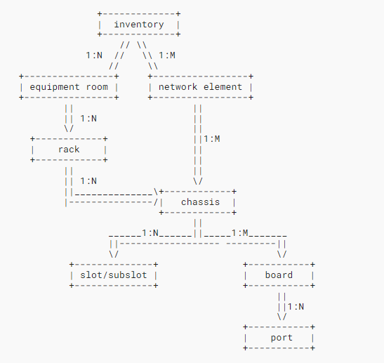
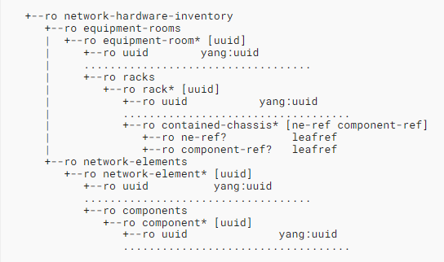
draft-ietf-ccamp-network-inventory-yang-01 A YANG Data Model for Network Hardware Inventory
 | ietf-network-hardware-inventory (prefix ni)

Slide 9
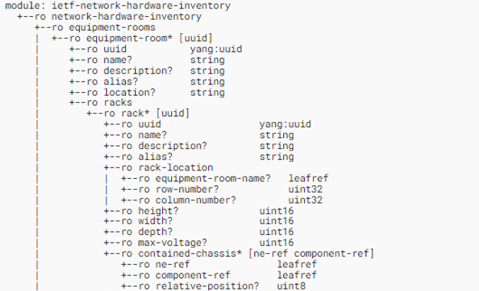
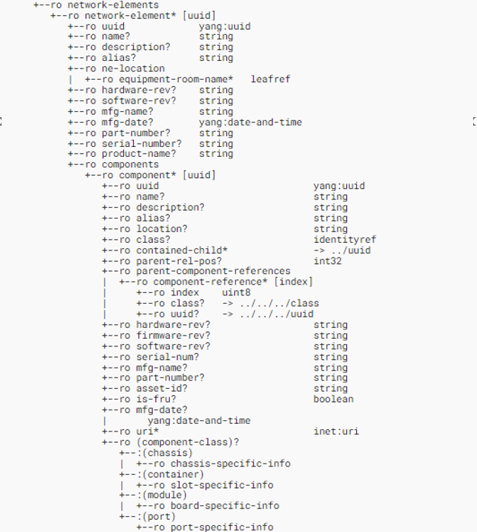
draft-ietf-ccamp-network-inventory-yang-01 A YANG Data Model for Network Hardware Inventory

Slide 10
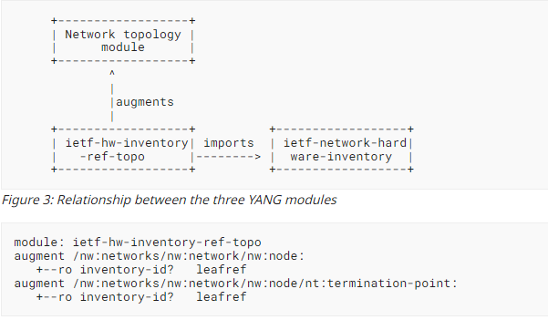
draft-ietf-ccamp-network-inventory-yang-01 A YANG Data Model for Network Hardware Inventory
uuid of a network element in ietf-network-hardware-inventory
uuid of a port component in ietf-network-hardware-inventory

Slide 11
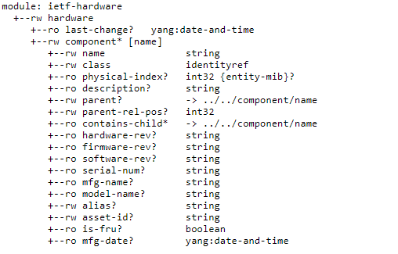
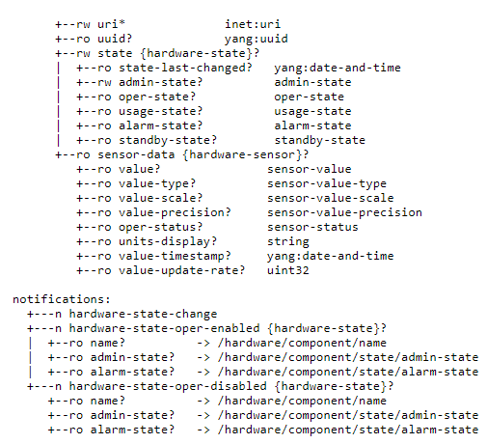
RFC 8348 A YANG Data Model for Hardware Management

Slide 12
Background Information from Nokia ends here...

Slide 13
Take-aways in C
Several sources suggest to reference a network equipment inventory from the network topology physical infrastructure layer
IETF Network HW inventory looks like a good reference for BBF equipment inventory TR 454 i2
(Haomian) Support and would like to start with “draft-ietf-ccamp-network-inventory-yang”, and feedback to IETF if we find any comments;
(Haomian) To clarify the relationship with the current ‘bbf-equipment-inventory’ and ‘bbf-network-map’, an overwrite?;
Only network HW (⬄ TR 454 EI also include pAN, (=PMA for access node))
Includes also node HW sub-components (chassis, slots, boards, cages) (⬄ TR 454 EI)
Does not include home devices (⬄ TR 454 EI)
(Haomian) draft-ietf-ccamp-network-inventory-yang defines a generic and hierarchical definition which in general also support home devices with new type definition. Technology-specific inventory attributes can be extended for ONU, AP, STA, ODN, see more details in the following pages.
We might also refer to multiple OSS subsystems NB of Access SDN M&C which represents reality (not only CloudCO DO)
(Haomian) Any example scenario?
Reference: https://wiki.broadband-forum.org/download/attachments/204472806/Inventory-Topology_4_17_2023.pptx?version=1&modificationDate=1681906477816&api=v2

Slide 14
Proposed Model Structures
ietf-network-hardware-inventory
ONU Augmentation
Home Gateway
Augmentation
Access Point
Augmentation
Others...
ietf-network-hardware-inventory defines a network-scope inventory model. It contains generic definitions for inventory objects as well as their hierarchical parent-child relationships.
Augmented inventory models for PON and home devices:
Inventory YANG model for ONU – defines ONU network-facing inventory parameters for multiple PON types
Home gateway YANG model – defines user-facing inventory parameters for home gateways
Consideration: can we merge ONU inventory with home gateway?
Access point YANG model – defines inventory YANG models for Wi-Fi AP

Slide 15
ONU Inventory Model
Augments the ietf-network-hardware-inventory
Inherits common/generic attributes for inventory objects from the base model
Reuses common ONU attributes defined in the common YANG models per TR-383
Consideration: need to align common attributes defined in the above two models
Key features in ONU Augmentations
Add ONU specific attributes for different PON types
Consideration: evaluate whether these ONU attributes are defined in separate containers or defined under the common container in ietf-network-hardware-inventory
Supports different FTTx modes
Supports different terminal types

Slide 16
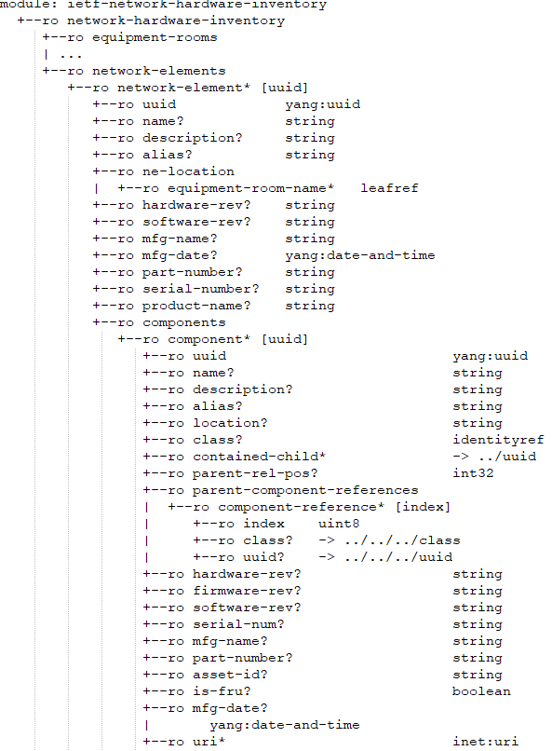
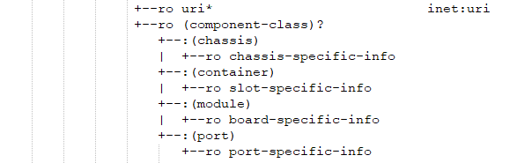
ONU Model Tree (Sample)
network-element : ONU
Common reusable attributes
+--:(onu-port)
| +--ro onu-port-specific-info
+--:(onu-link)
+--ro onu-link-specific-info
ONU component attributes
ONU components: ports, links
...
|
+--ro onu
+--ro down-bw?
+--ro ref-parent-ltp
+--ro pon-type
+--ro loid
+--ro voip-address
+--ro onu-id
+--ro fttx-mode
+--ro mac-address
+--ro onu-class
+--ro onu-type
+--ro bandwidth-type
+--ro terminal-type
+--ro tags
ONU specific attributes

Slide 17
Home Gateway Inventory Model
Augments the ietf-network-hardware-inventory
Inherits common/generic attributes for inventory objects from the base model
Reuses common ONU attributes defined in the common YANG models per TR-383
Consideration: need to align common attributes defined in the above two models
Key features in home gateway augmentations
Definition of home gateway models

Slide 18
Home Gateway Model Tree (Sample)
network-element : home-gw
Common reusable attributes
+--:(home-gw)
| +--ro home-gw-specific-info
home gateway component attributes
Home gateway components?
...
|
+--ro home-gw
+--ro model?
Specific attributes for home gateways

Slide 19
Wi-Fi AP Inventory Model
Augments the ietf-network-hardware-inventory
Inherits common/generic attributes for inventory objects from the base model
Reuses common ONU attributes defined in the common YANG models per TR-383
Consideration: need to align common attributes defined in the above two models
Key features in the augmentations
Common reusable grouping definition for APs
ssid-info, neighbor-ssid-info
uplink-pon-info
common-error-info
Extensible opaque attribute for vendor implementation
Definition for supported Wi-Fi bands
Definition for connected home devices

Slide 20
Wi-Fi AP Model Tree (Sample)
network-element : wifi-ap
Common reusable attributes
...
|
+--ro home-ap
+--ro ap-info
| +--ro ap-list* [mac]
| +--ro mac?
| +--ro manufacture-oui?
| +--ro wifi-band-capability?
| +--ro standard-capability?
| +--ro up-link?
| +--ro work-mode?
| +--ro uplink-pon
| | +--ro transmitting-power?
| | ...
| +--ro additional-info* [name]
| +--ro name?
| +--ro value
+--ro wifi-band
+--ro mac?
+--ro radio-type?
+--ro auto-channel?
+--ro channels*
+--ro channels-in-use*
+--ro ssid-list* [ssid-index]
AP components
Specific attributes for APs

Slide 21
Summary
Augmented inventory data models for ONUs, home gateways and Wi-Fi APs based on ietf-network-hardware-inventory
Reuse common attributes from the base model and TR-383

